Slide 1
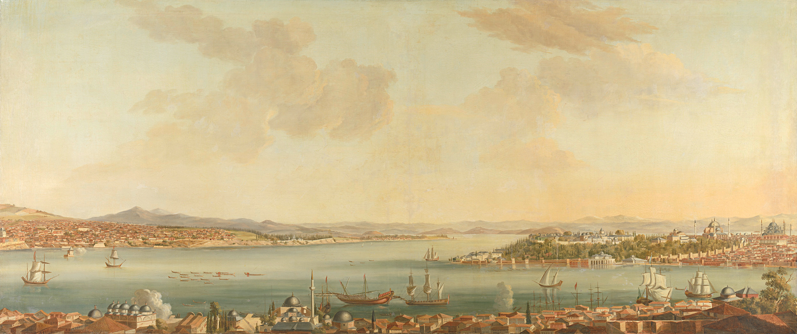
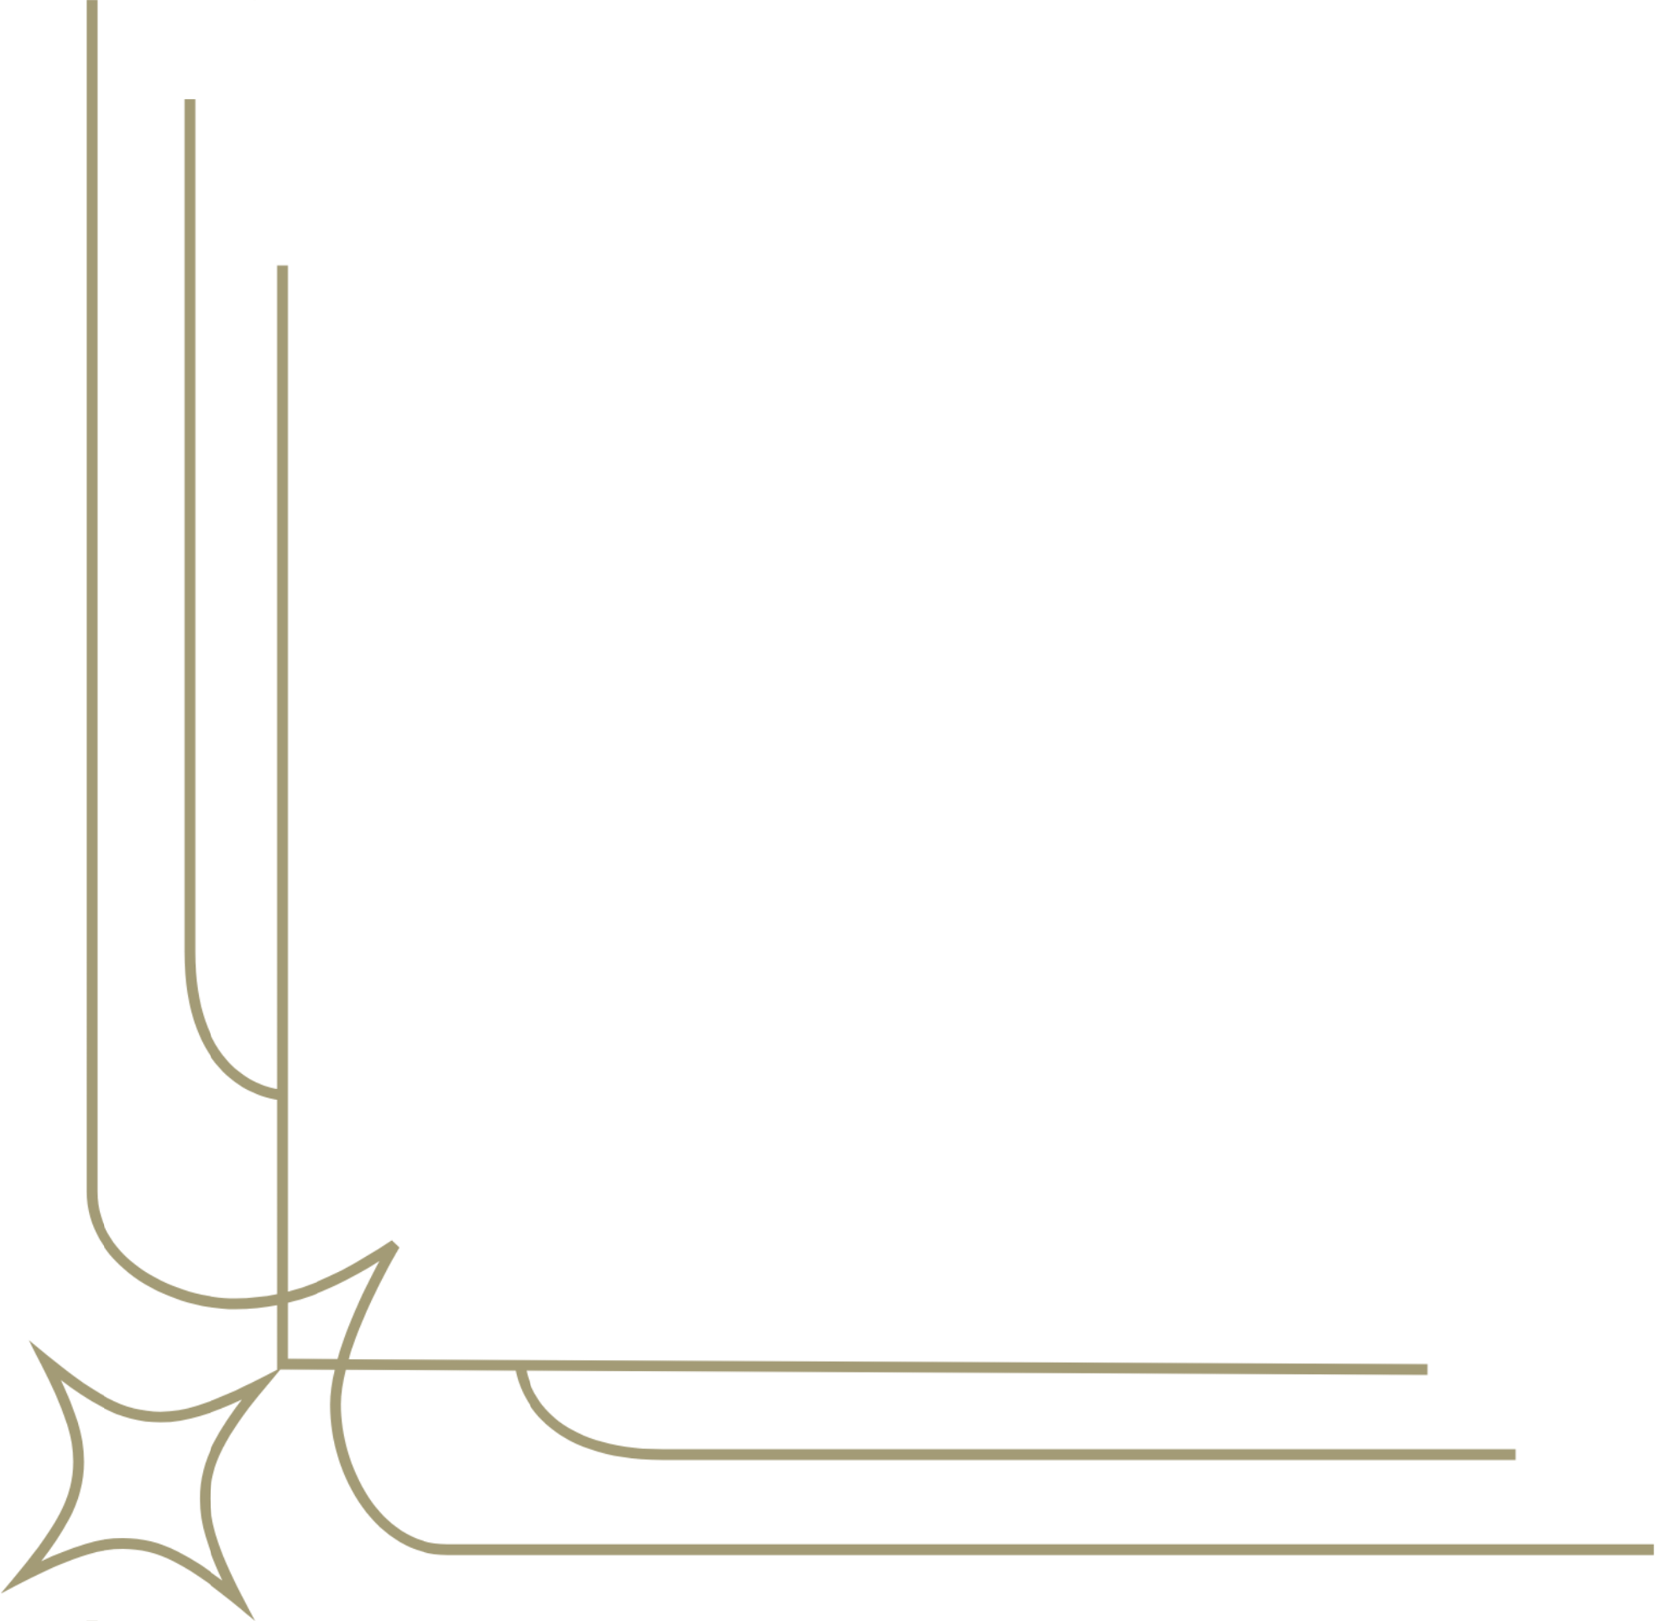
Branding the American Self, Self-fashioning, and Violence in The Old Man and The Sea
Presenters :
Syeda Sanjana Tasnim Preya (2020236028)
Naimur Rahman Tareq (2020236010)
Md. Isfak ali (2020236005)
Yeasin Arafat (2019236024)
Shuaib Ahmed Chowdhury (2020236023)

Slide 2
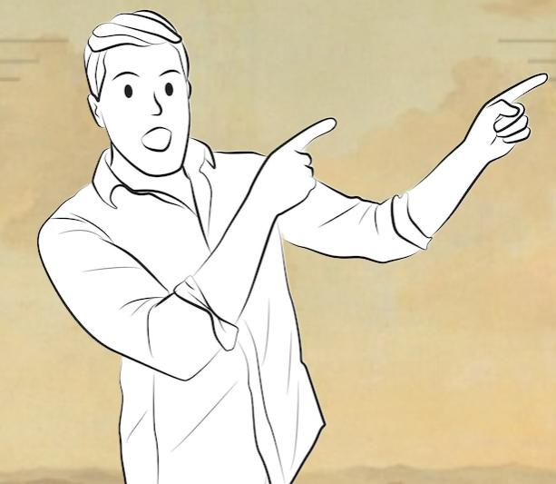
Exploring Ideas
Branding the American Self
Self-fashioning
Violence
Connection to The Old Man and the Sea

Slide 3
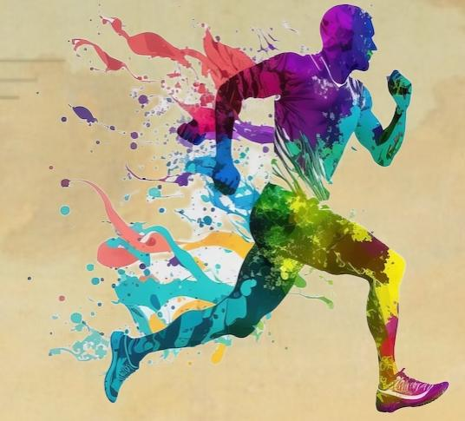
Branding the American Self
Creating an identity that reflects traditional American Values.
Independence, Determination, Hard-work, Resilience, Strength.
“ Brand” themselves.
“Self-made” Person
“American Dream”
Real-life Example:
Athletes
Entrepreneurs etc.

Slide 4
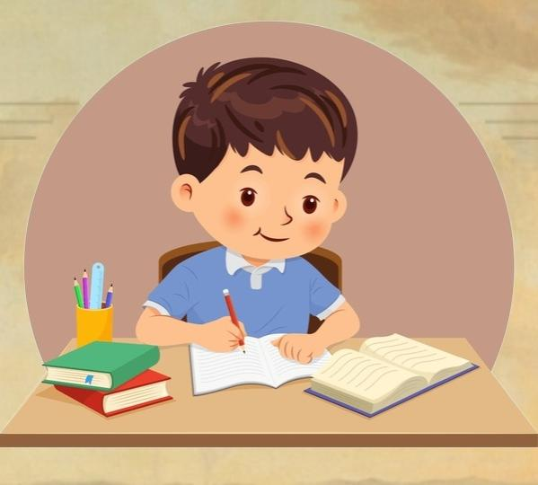
Self-fashioning
Shaping identities through Actions, choices, and beliefs.
Building own identities
Real life Example:
Dedicated learner

Slide 5

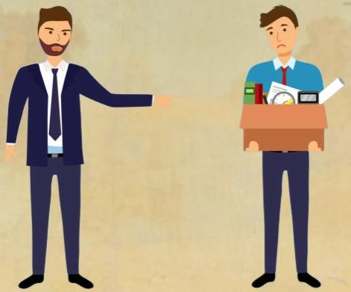
Violence
Symbolizes struggles or challenges
Test strength and Resilience
Fighting against world, nature or themselves.
Real life Example :
Jobless person
Dealing with serious illness

Slide 6
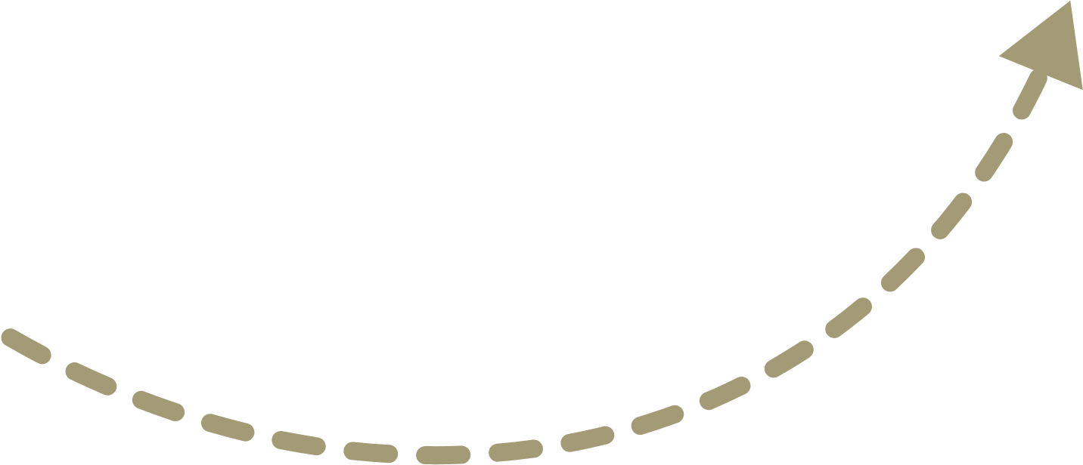
How the ideas are connected to The Old Man and the Sea
Perseverance
Self-made Person
“A man can be destroyed but not defeated “
American culture
Enduring pain and struggle
“I will fight them until I die”
Internal violence
Self-fashioning
Past victories
“EI Champeon” (The Champion)
Identity as a Proud and enduring fisherman
Branding the American self
Violence

